Slide 1
Tweeting a positive message to the world with Twithon
Notes:
[Mandatory Slide] This would be the introduction slide of the topic that you are covering in this subsection.
When this slide plays, you could talk about the main aim that we’d be covering in this video.

Slide 2
In this Video, we are going to take a look at…
Setup your Twitter account
Setup Twython
Code sample
Notes:
[Mandatory Slide]
Before the start of the video, we’d like to highlight what are important topics or pointers that we’d be covering in this video. This slide would immediately follow the intro/name slide. This would just be say 2-3 points for the viewers to know what they are getting into.

Slide 3
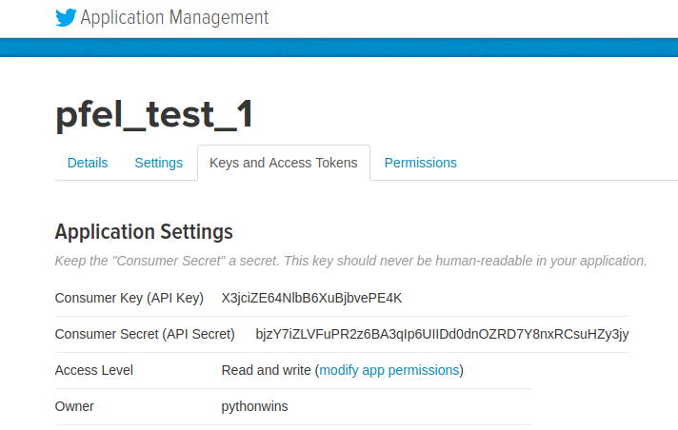
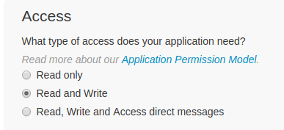

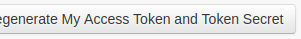
Setup your Twitter account
If you don’t already have one, open up a new Twitter account at http://twitter.com
Go to https://apps.twitter.com/ and create a new app after filling in the required info. Make sure your app’s permissions encompass both “read” and “write”
Take note of your app’s Consumer Key and Consumer Secret. Then create an Access Token and take note of it and of the related Access Token Secret
Notes:
[Mandatory Slide]
Before the start of the video, we’d like to highlight what are important topics or pointers that we’d be covering in this video. This slide would immediately follow the intro/name slide. This would just be say 2-3 points for the viewers to know what they are getting into.

Slide 4
Setup Twython
Twython is a Twitter API SDK that makes it easy to read and send tweets. Install it with:
pip install twython
Notes:
[Mandatory Slide]
Before the start of the video, we’d like to highlight what are important topics or pointers that we’d be covering in this video. This slide would immediately follow the intro/name slide. This would just be say 2-3 points for the viewers to know what they are getting into.

Slide 5
Code sample
Notes:
Something that needs to grab the viewers attention!!

Slide 6
Summary
Setup your Twitter account
Setup Twython
Code sample
Notes:
[Mandatory Slide]
Before the start of the video, we’d like to highlight what are important topics or pointers that we’d be covering in this video. This slide would immediately follow the intro/name slide. This would just be say 2-3 points for the viewers to know what they are getting into.

Slide 7
Tracking all of your personal notes using the Evernote API
Next Video
Notes:
[Mandatory Slide]
Here the name of the next video needs to be mentioned. The narration as you guessed it would be just letting the viewer know exactly where we are at and what we’d be taking over next! ☺

